Slide 1

WELCOME

Slide 2
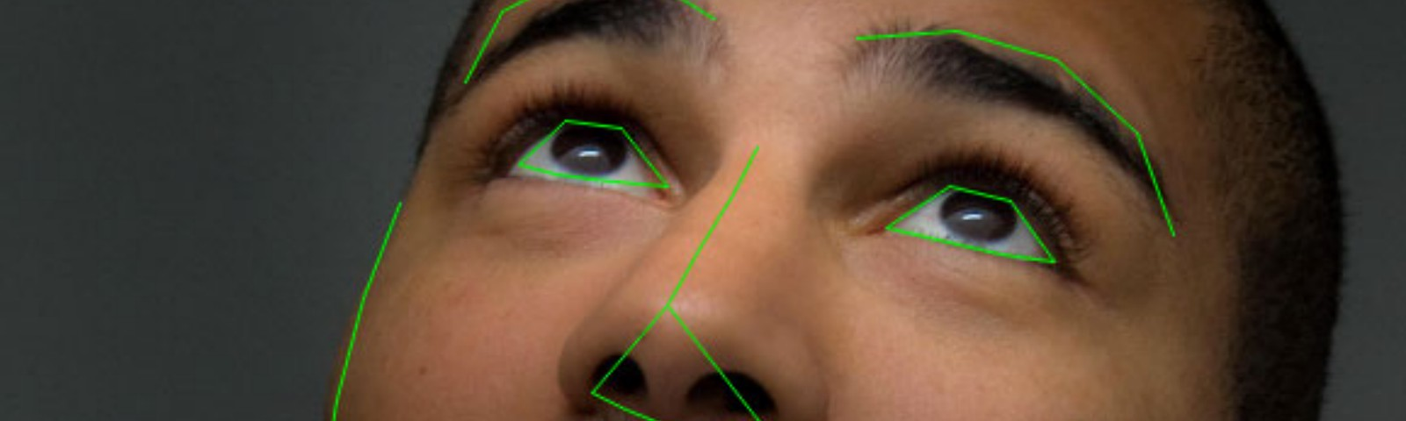
DROWSINESS DETECTION AND ALERT SYSTEM
BY:
G.ROHINI
A.SRI SOWMYA
A.PRAMIDHA
K.ANUSHA

Slide 3
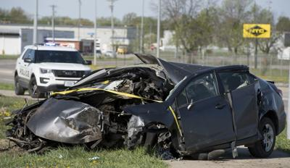
OBJECTIVE
Drowsiness and fatigue of the drivers is amongst the most specific causes for road accidents. Our objective of the project is to ensure the road safety system. For enhancing the safety, we detect the eye blinks of the driver and estimate the driver status.

Slide 4
INTRODUCTION
Vehicle accidents are more common if the driving is inadequate.
These happen on most factors if the driver is drowsy or if he is alcoholic.
It was demonstrated that driver performance deteriorates with increased drowsiness with resulting crashes constituting more than 20% of all vehicle accidents.

Slide 5

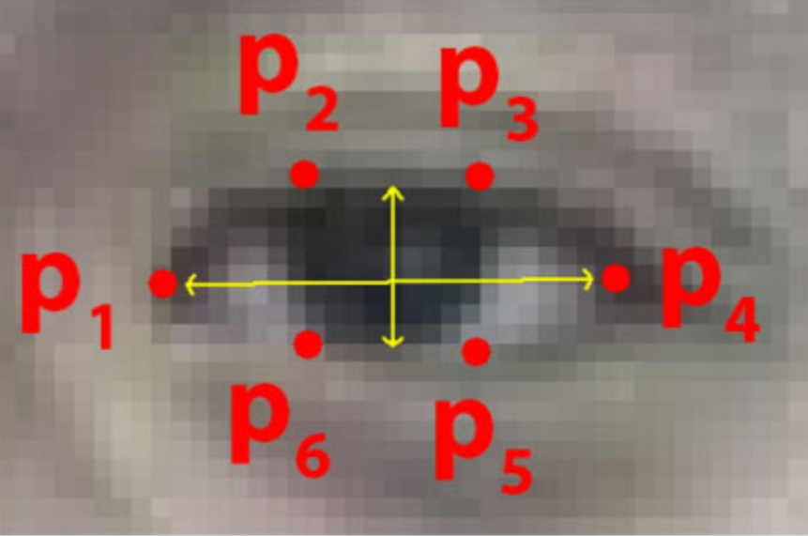
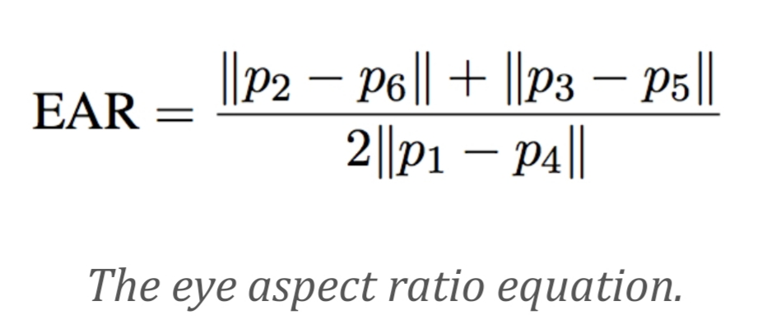
PROPOSED IDEA
This project involves controlling vehicle accidents and saving driver’s life by alerting him
Whenever the driver’s eye blinking period is more, we consider this condition under drowsiness
Immediate action will be taken and buzzer will blow up alerting the driver.

Slide 6
SOFTWARE REQUIREMENTS
Python IDE
Anaconda
HARDWARE REQUIREMENTS
Laptop embedded with a webcam

Slide 7
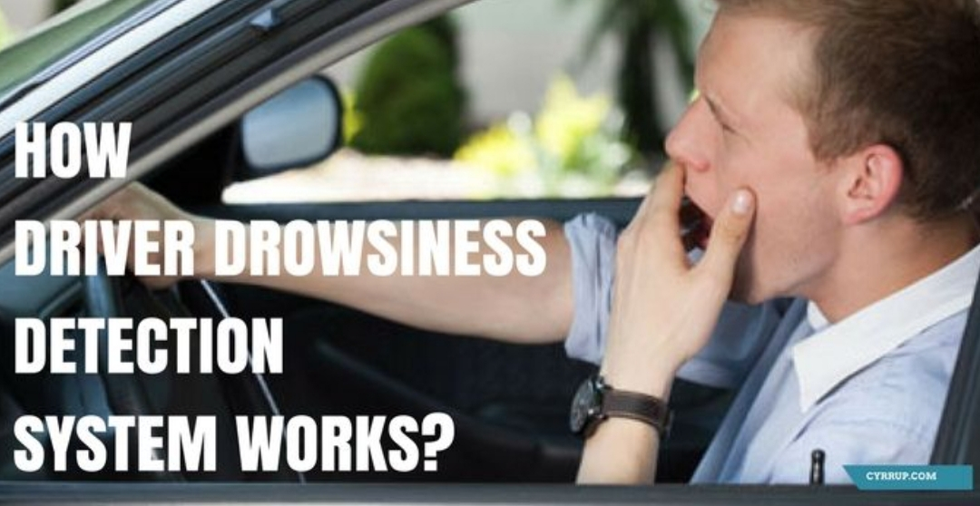

Slide 8
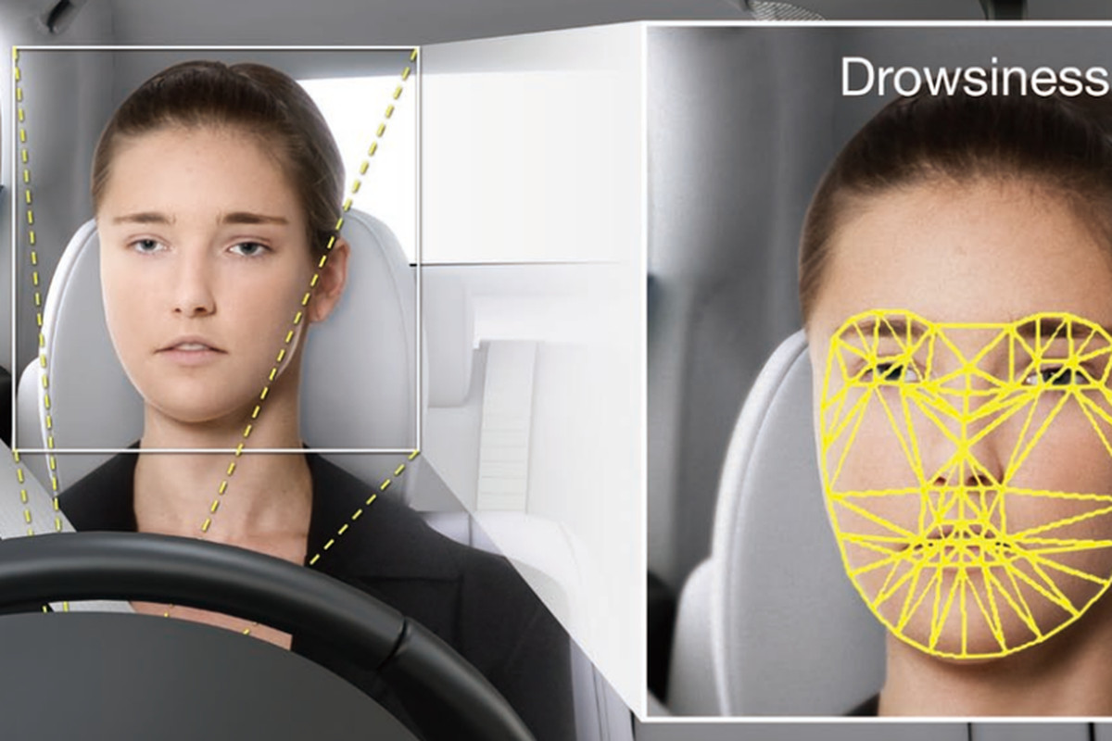
METHODOLOGY
The eye blink of the driver and estimating the driver status and producing an alert. On the whole by sensing the eye blinks we can decide the drowsiness. If the eye blink duration of the driver is more then we can conclude that he is drowsy.
As the drowsiness is detected an alarm is produced. This helps the driver to get out of his drowsiness.

Slide 9
FLOWCHART
Start
Video aquisition
Face detection
Drowsiness detection
yes
Buzzer will beep
stop

Slide 10
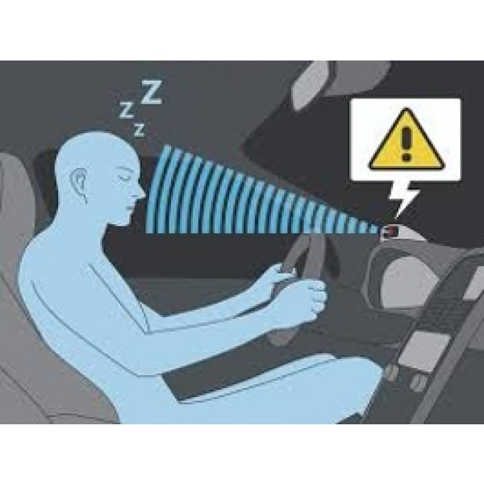

Slide 11
Future’s
Anti-drowsiness alarm
Make easy drive
Drink and drive production
Medical accent
Direct interface to any hardware using Arduino
Low cost
High security
This program can be used for Aircraft also

Slide 12
Thank You

